Slide 1
Object Oriented System Design
Assignment #3

Slide 2
Game cafe: Part 3
This assignment uses the code base you created in the first assignment.
Buying coffee
Threading
Observer pattern
Arraylist
Inner class

Slide 3
Class GameCorner
Variables:
private ArrayList<Game> gamesInCafe;
private ArrayList<Game> rentedOutGames;
Methods:
public GameCorner(ArrayList<Game> games);
public double rentOutGame(String name); // Cost of renting is the game’s price * 0.5
public void returnGame(String name);
public void buyGame(Game game);
public void printCafeDetails(); // Prints all games in the cafe and rented out, and the money in the register
public double repairGame(String name);
private int getIndexGamesInCafe(String name); // Helper function to get the index of the given game in the array, -1 if game doesn’t exist.
private int getIndexRentedOutGames(String name); // Helper function to get the index of the given game in the array, -1 if game doesn’t exist.

Slide 4
Class CoffeeCorner implements Oberver
Variables:
private int coffeeIndex; // Set to 0 in constructor
private HashMap<String, Double> coffeetypes; // HashMap of coffee types with prices
private ArrayList<CoffeeMachine> machines; // Arraylist of all the available coffee machines
Methods:
public CoffeeCorner(int machineAmount);
public void listCoffeeTypes(); // Prints all types of coffee with the price
public int makeCoffee(String type); // Start preparing the coffee of the given type
public void update(int index); // Observer method, called when coffee is done from thread

Slide 5
Private class CoffeeMachine extends Thread implements observable
This class is an inner class of CoffeeCorner
Variables:
private ArrayList<Observer> observers; // List of observers
private int index; // Index of currently made coffee
private string machineName; // Name of the machine
Methods:
public CoffeeMachine(int index, String name);
public void run(); //Thread’s standard method
public void subscribe(Observer observer); //Add observer method
public void unsubscribe(Observer observer); //Remove observer method

Slide 6
Interface Observer
Methods:
public void update(int index, String name)
//this method gets called with the index of the coffee that is ready and the name of the machine that made the coffee

Slide 7
Interface Observable
Methods:
public void subscribe(Observer observer) //adds an observer to this observable
public void unsubscribe(Observer observer) //removes an observer from this observable

Slide 8
Main class
Variables:
double money //Money moved from gameCorner class to here
method main:
Initialize the CSVLoader
Initialize the GameCorner
Initialize CoffeeCorner with 2 coffee machines
Buy a coffee
Before the coffee is ready, rent a game to show you have implemented threading well
Buy a new game.

Slide 9
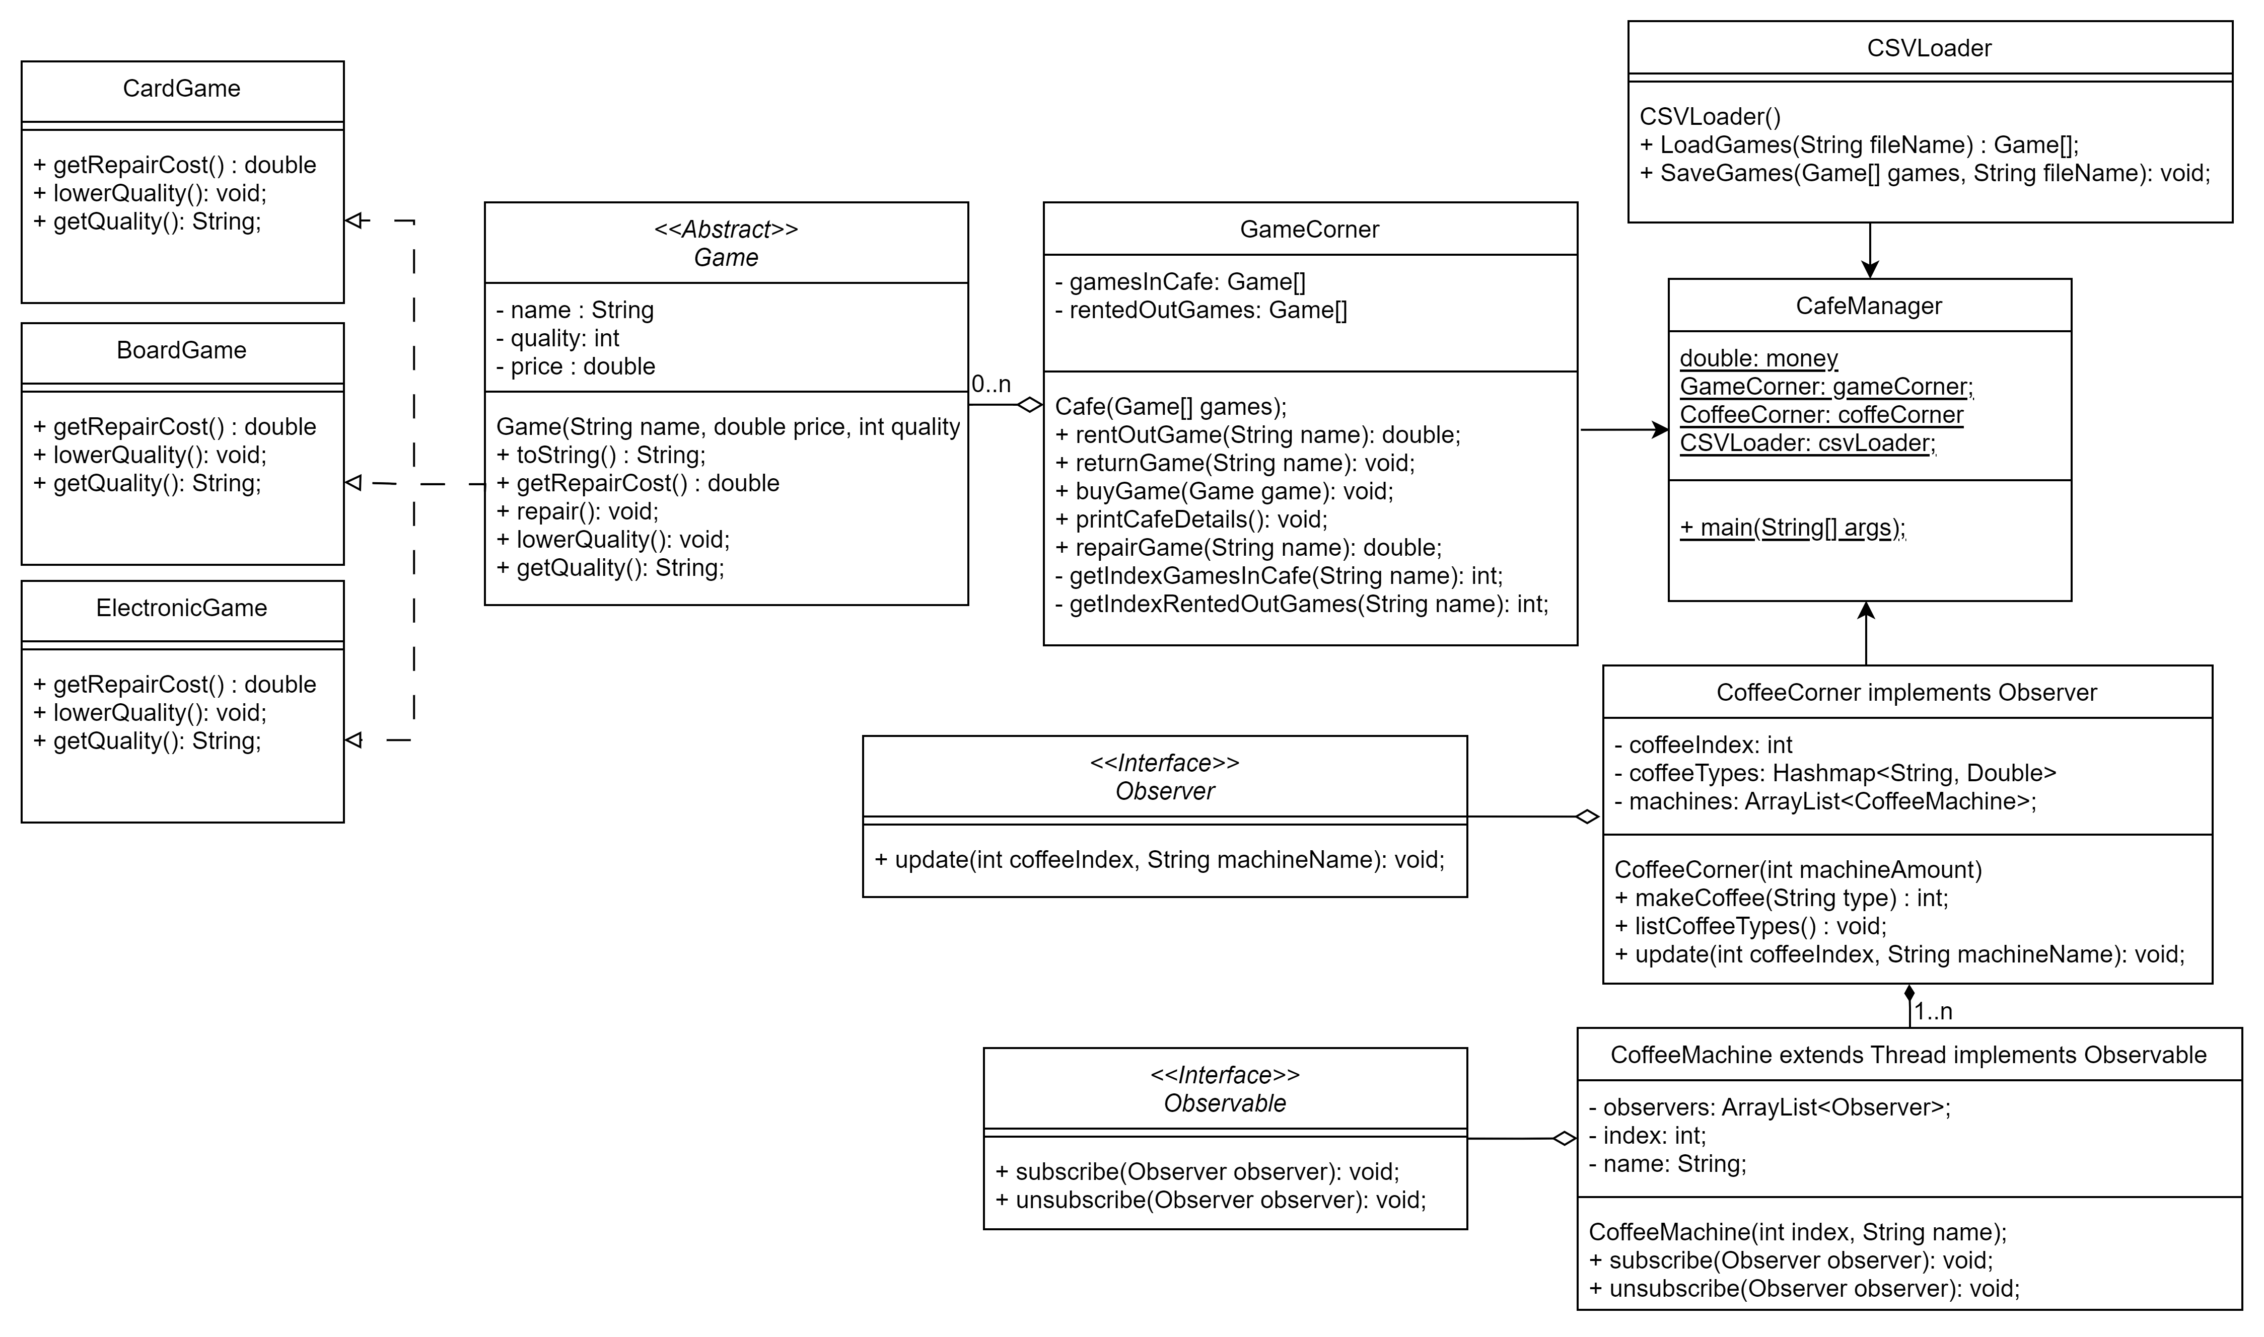
UML

Slide 10
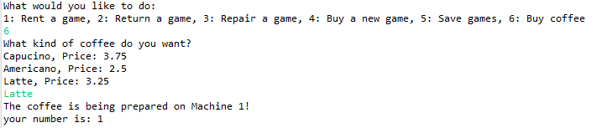
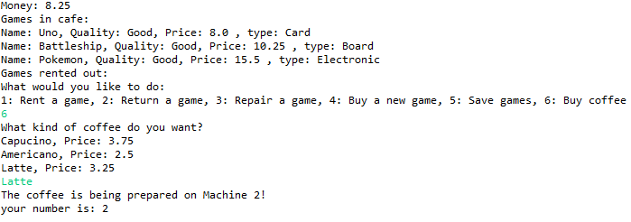
Visualization
Buying coffee (1)

Slide 11
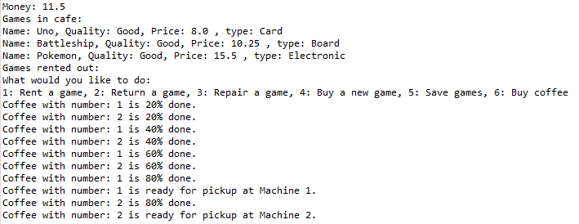
Visualization
Buying multiple cups coffee quickly after one another should make multiple threads run simulatiously

Slide 12
Rules
Only regular arrays [], no Lists or Maps.
Use getters and setters when needed and only make them public if they are actually meant to be used from outside the class.
Reading code is more difficult than writing code, place comments in complex methods.

Slide 13
Rules (2)
You are not allowed to add extra arrays for the games, make use of the existing gamesInCafe and rentedOutGames arrays.
You are not allowed to use external libraries to read the CSV file.
The CSVLoader has to utilize exception handling
The system should not crash when the given filename is not found.
The system should not crash when the data in the file is not well formatted (ex: empty file, wrong data types).

Slide 14
Rules (3)
You have to be able to keep using the cafe when coffee is being prepared
Use the observer pattern for notifying the CoffeeCorner about the coffee
Make use of interfaces when implementing the observer pattern
The coffee machines give updates every 20% until the coffee is ready
Making the coffee should take around 10 to 15 seconds for testing purposes
The CoffeeCorner has at least 2 coffee machines
Alternate the coffee machines every time you make a coffee

Slide 15
Hints
Using a HashMap is one of the best ways to keep a key-value pair list, you will learn about this in the last week so here is a hint on how to use it.
EN: https://www.w3schools.com/java/java_hashmap.asp
KR: https://coding-factory.tistory.com/556

Slide 16
Submission
Submit your program code package(Assignment3_code_이름_학번) and design document (Assigment3_이름_학번) in LMS. (Korean/English)
The design document describes the main methods, flow of the code and overall design of the program. It should also mention and explain every method that you added that was not described in this powerpoint.
Deadline: 18th of june (6월 18일)23:59
Late penalties:
Up to 24 hours = -25%,
24-48 hours = -50%,
48-72 hours = -75%
after 72 Hours you get an automatic 0.

